Slide 1
Entrepreneurship and Innovation
By
Dr. Raveendra Rao K
MIT, Manipal

Slide 2
Creativity as a prerequisite to Innovation
Creativity is “the ability to bring something new into existence.
Innovation is the process of doing new things
Ideas have little value until they are converted into new products, services or processes. Innovation, therefore, is the transformation of creative ideas into useful applications, but creativity is a prerequisite for innovation.

Slide 3
Creative process
Preparation: Conscious search for knowledge (Rationalization )
Incubation: Subconscious assimilation of information
(Fantasizing )
Idea Generation/Recognition
Illumination: Recognition of ideas as being feasible
(Realization)
Verification: Application or test to prove idea has value
(Validation)

Slide 4
Elements in Innovation Process
Translation of creative idea into useful application
To identify: To Obtain: To accomplish: To Provide:
Pdt design, Materials Organization Value to customers
Market Strategy, Technology Product design Rewards for employees
Financial needs HR, Capital Manufacturing Revenue for investors
Services Satisfaction to founders
Analytical Planning
Organizing resources
Implementation
Commercial Application

Slide 5
Key people in Technological innovation
Creative Source: Inventor or originator of idea
Champion: Entrepreneur or Manager who pursues the idea, planning its application, acquiring resources and establishing its markets
Sponsor: Who makes Champions dream come true through support and financing.

Slide 6
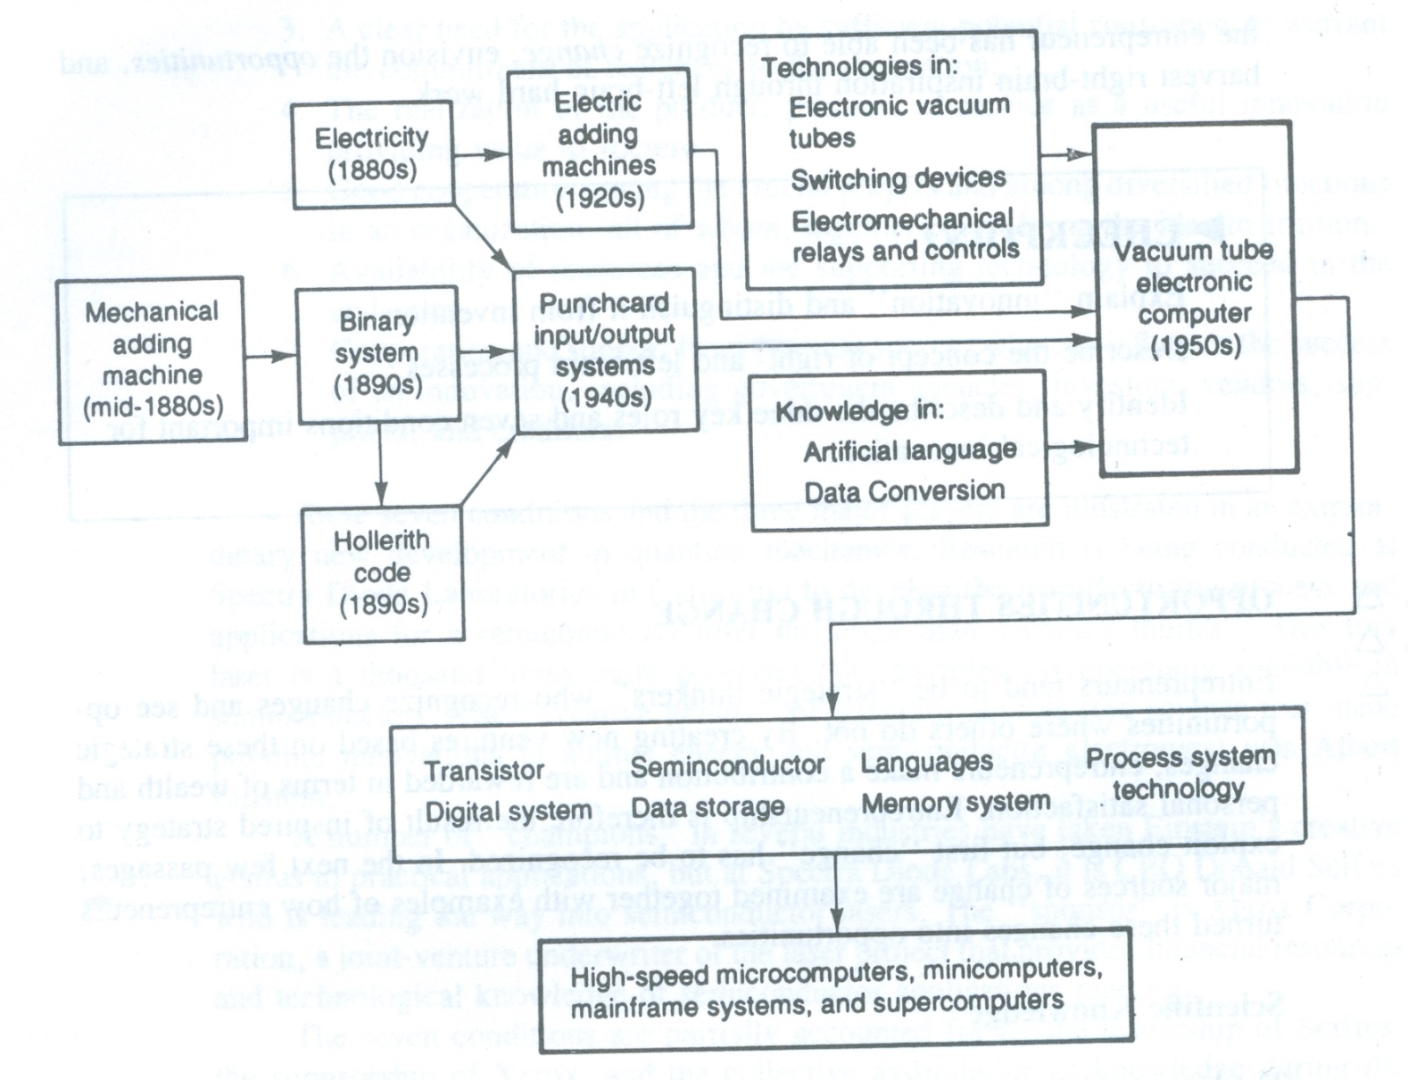

Slide 7
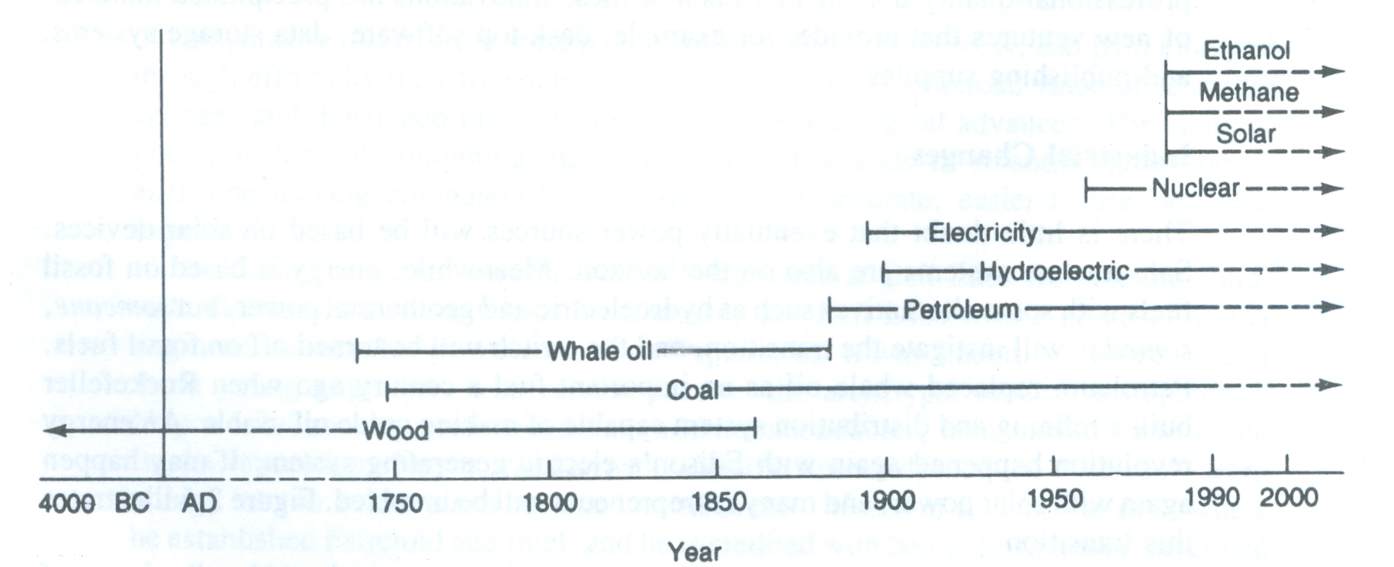

Slide 8
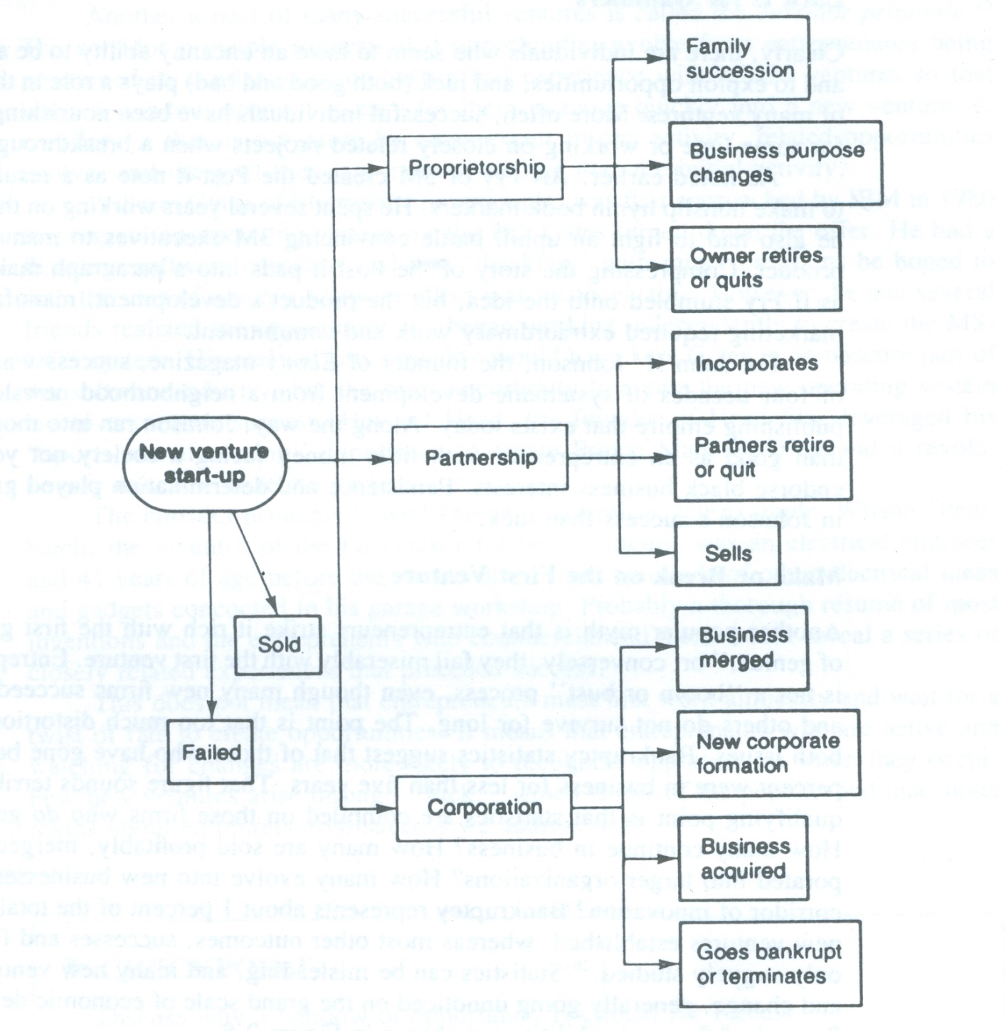
Possible changes in New venture status

Slide 9
Windows : A window is a time horizon during which opportunities exist before something else happens to eliminate them.
Corridor principle: Opportunities evolve from entrepreneurs being positioned in a similar work or having had experience with related ventures so that when a window opens , its easy for them to enter new venture.

